Slide 1


Welcome to Deep Learning programming!
Keras for Deep Learning Research

Slide 2
Feedback is greatly appreciated!

Slide 3

Objective
What is Deep learning
Application of Deep learning
A brief introduction to how Deep Learning works
Introduction to Keras library
Basic operations in Keras
Use case: diabetes prediction

Slide 4
What is Deep Learning?
Deep learning is a subset of machine learning in artificial intelligence that imitates the workings of the human brain in processing data and creating patterns for use in decision making

Slide 5
What can Deep Learning do?

Slide 6
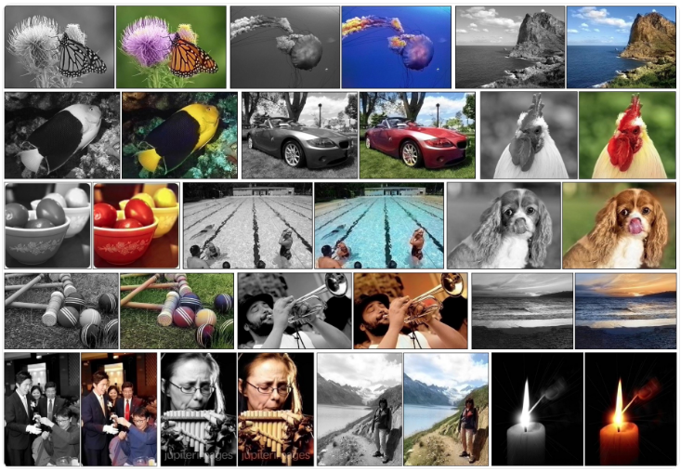
What can Deep Learning do?
Colorization of Black and White Photographs
https://machinelearningmastery.com/inspirational-applications-deep-learning/

Slide 7
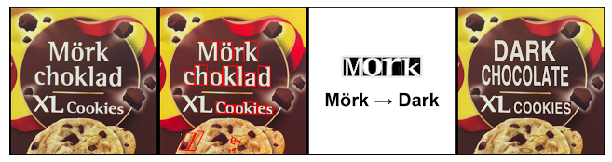
What can Deep Learning do?
Instant Visual Translation
https://machinelearningmastery.com/inspirational-applications-deep-learning/

Slide 8
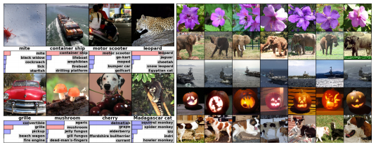
What can Deep Learning do?
Example of Object Classification
https://machinelearningmastery.com/inspirational-applications-deep-learning/

Slide 9
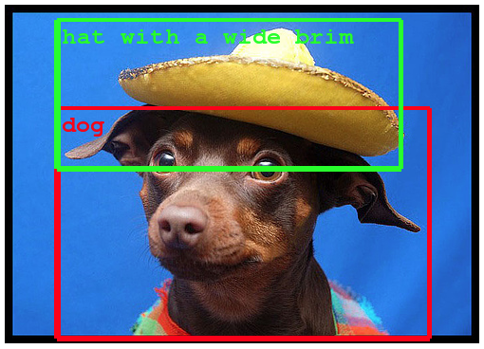
What can Deep Learning do?
Example of Object Detection within Photographs
https://machinelearningmastery.com/inspirational-applications-deep-learning/

Slide 10
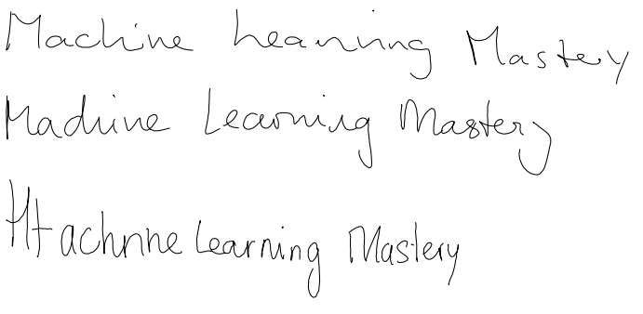
What can Deep Learning do?
Sample of Automatic Handwriting Generation
https://machinelearningmastery.com/inspirational-applications-deep-learning/

Slide 11
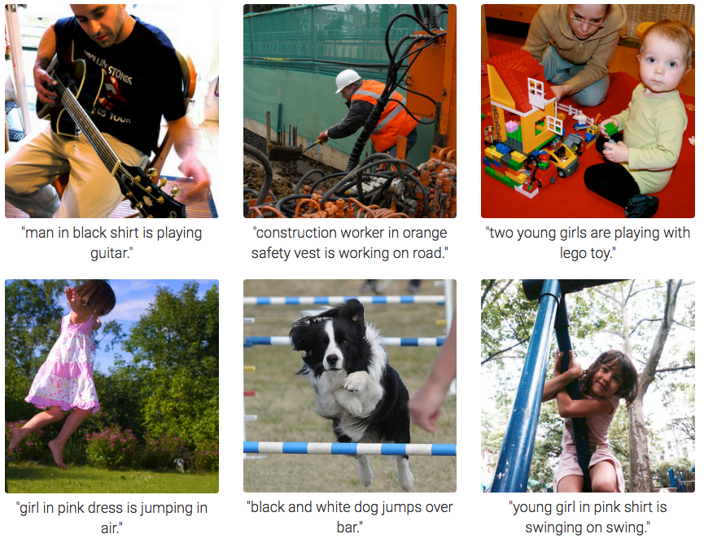
What can Deep Learning do?
Automatic Image Caption Generation
https://machinelearningmastery.com/inspirational-applications-deep-learning/

Slide 12
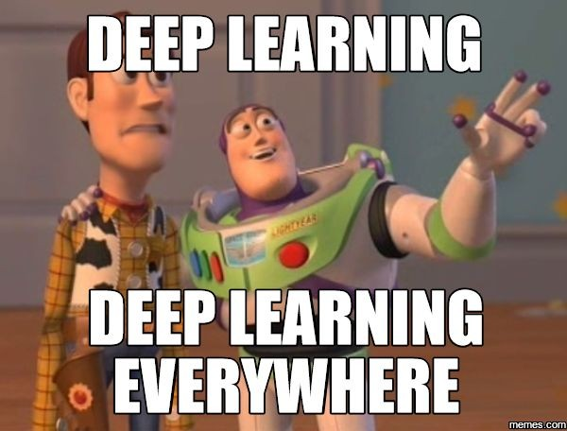
What can Deep Learning do?
Natural Language Processing
Speech Processing
Computer Vision and
Many more

Slide 13
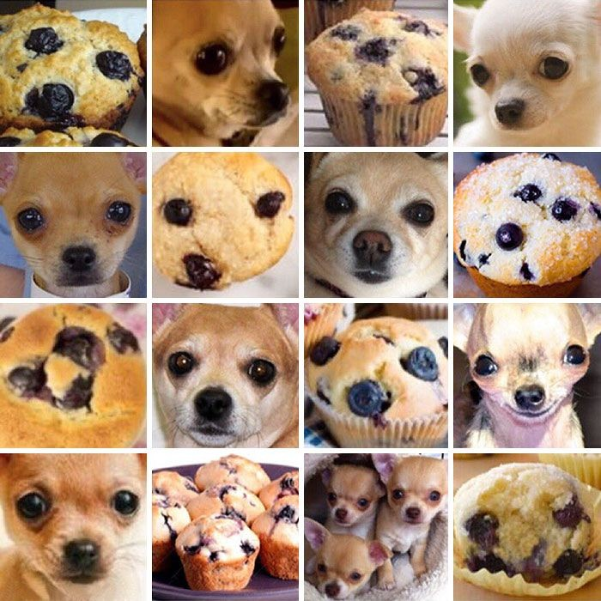
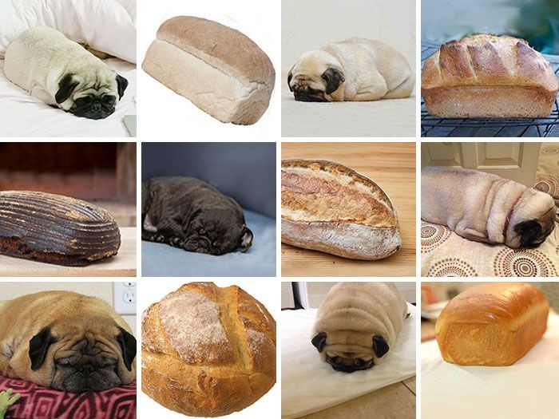
Challenges!

Slide 14
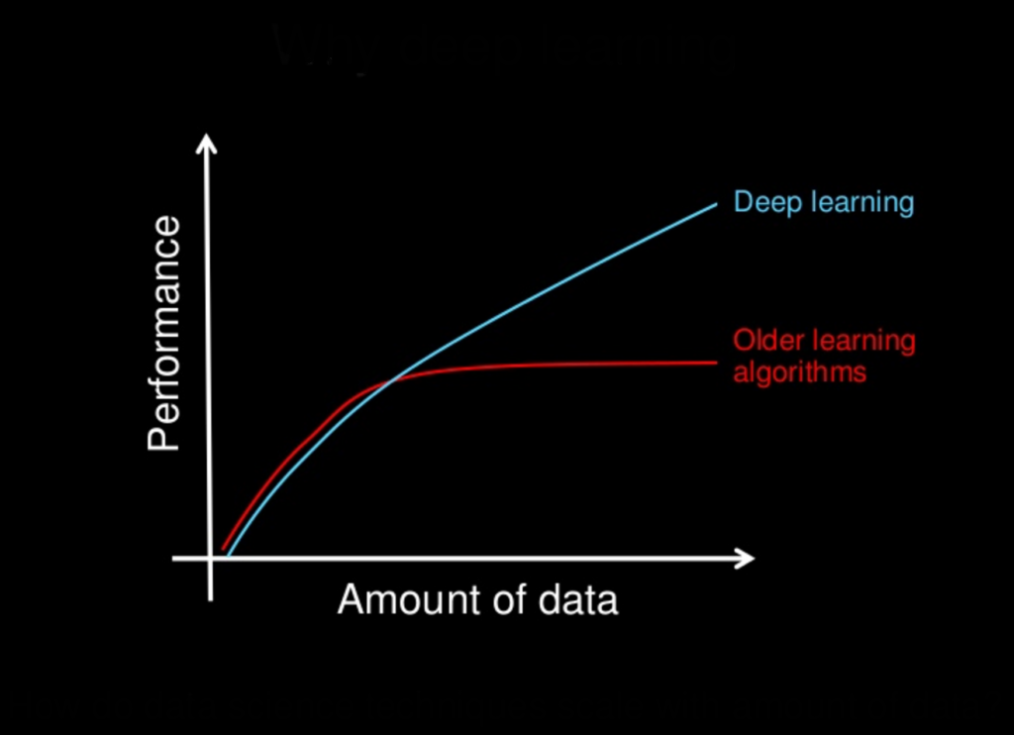
Why is Deep Learning?
https://machinelearningmastery.com/what-is-deep-learning/

Slide 15
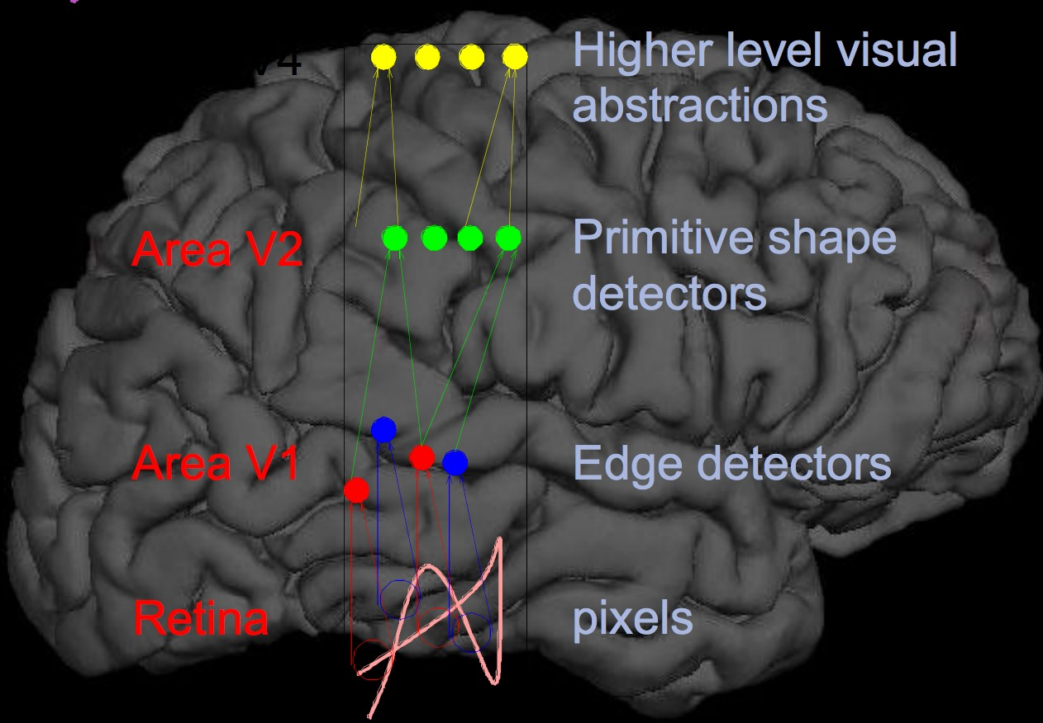
"Brain"-like: Feature Hierarchies
A deep learning model is designed to continually analyze data with a logic structure similar to how a human would draw conclusions

Slide 16

How does Deep Learning work?
How to realize and differentiate circle and square?

Slide 17
Hierarchical feature extraction in Deep Learning
The first thing our eyes do is
1. Check whether there are 4 lines associated with a figure or not
2. If we find 4 lines, we further check, if they are
a. connected
b. closed
c. perpendicular
d. they are equal as well

Slide 18
Hierarchical feature extraction in Deep Learning
So, we took a complex task (identifying a square) and broke it in simple less abstract tasks
Deep Learning essentially does this at a large scale

Slide 19
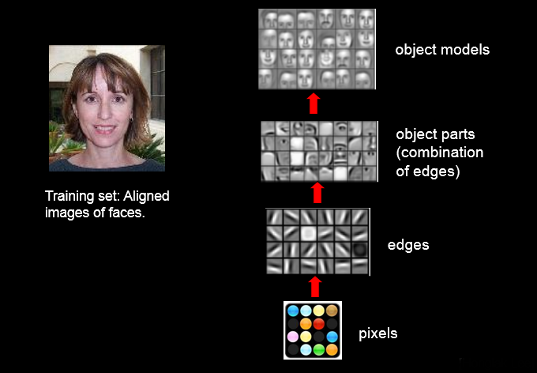
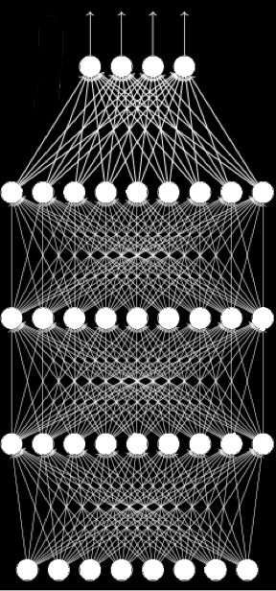
Feature Hierarchies: Vision
output layer
hidden layer
input layer

Slide 20
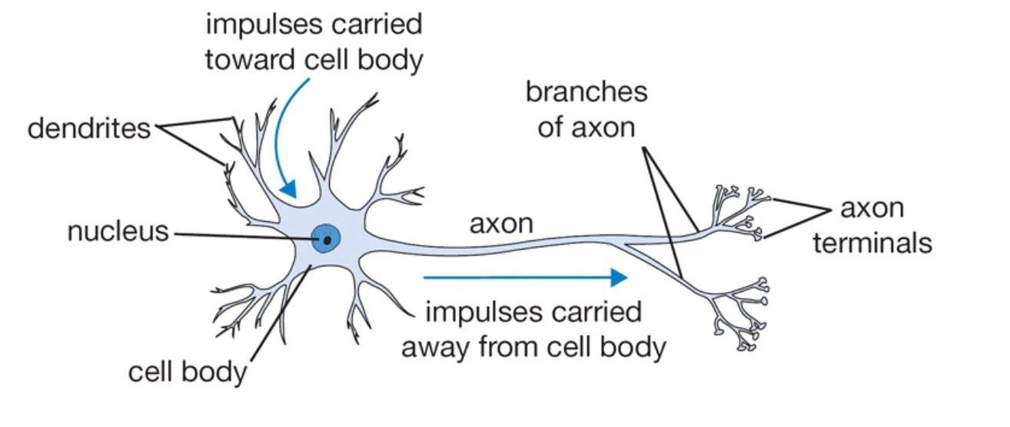
Biological Neuron

Slide 21
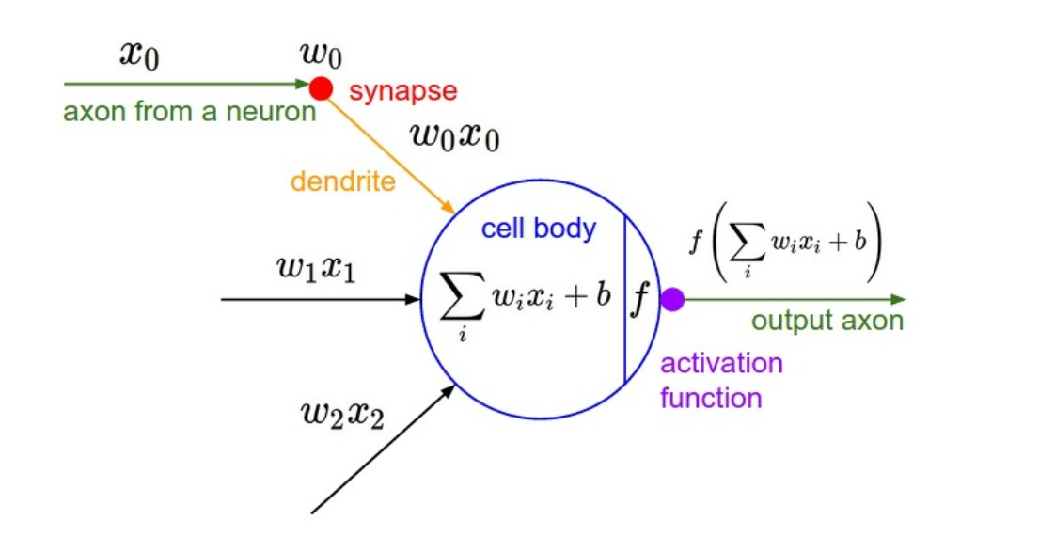
Artificial Neurons

Slide 22
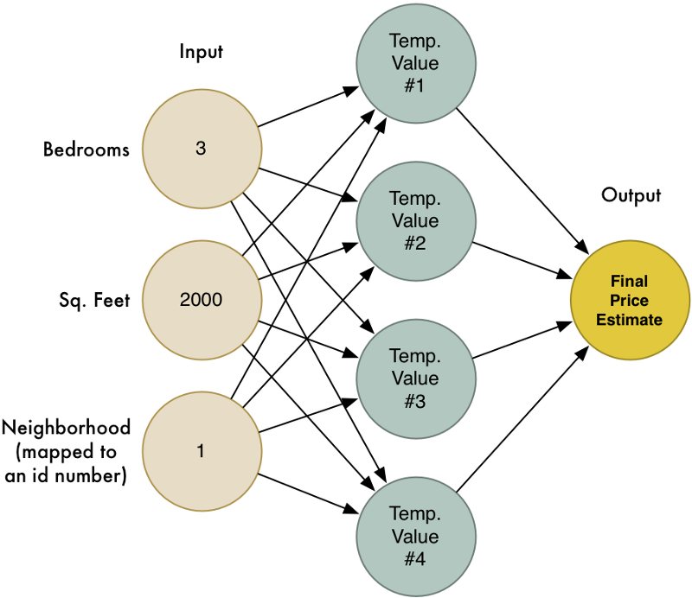
House price prediction neural network

Slide 23
Deep Learning Libraries and Platforms

Slide 24
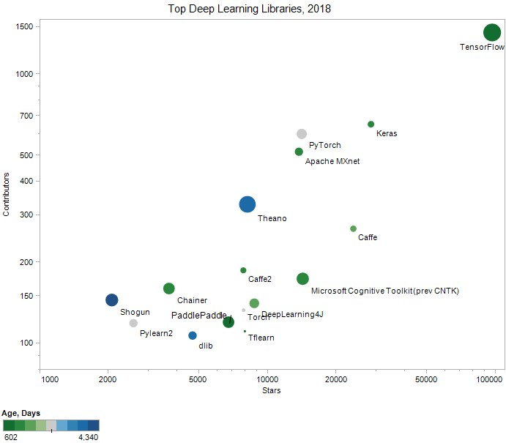
Deep Learning Libraries
TensorFlow
Keras
Caffe
Microsoft Cognitive Toolkit
PyTorch
Apache MXnet
DeepLearning4J
Theano
TFLearn
Torch
Caffe2
PaddlePaddle
DLib
Chainer
Neon
Lasagne
https://www.kdnuggets.com/2018/04/top-16-open-source-deep-learning-libraries.html

Slide 25










Industry traction
etc...

Slide 26
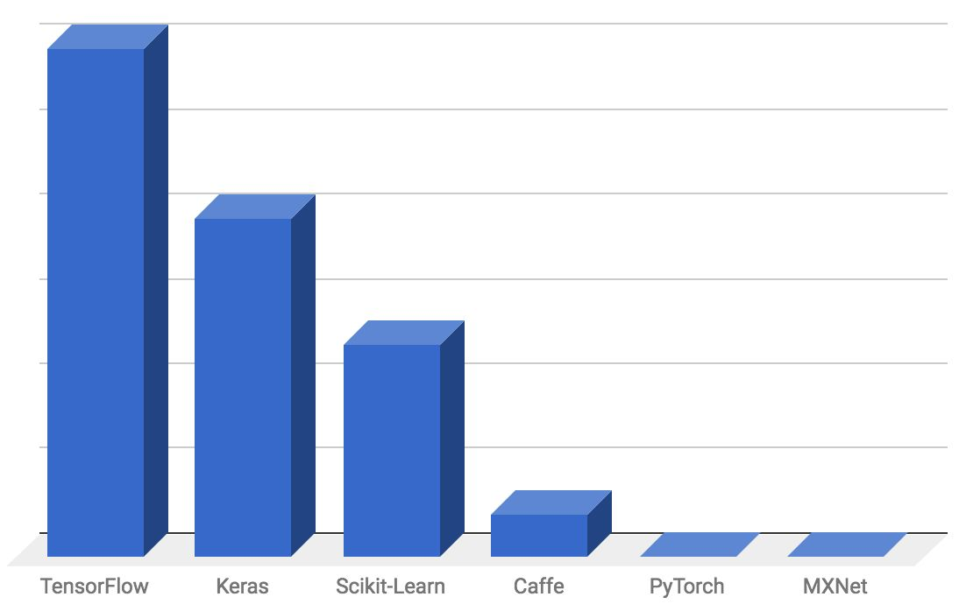
Startup-land traction

Slide 27
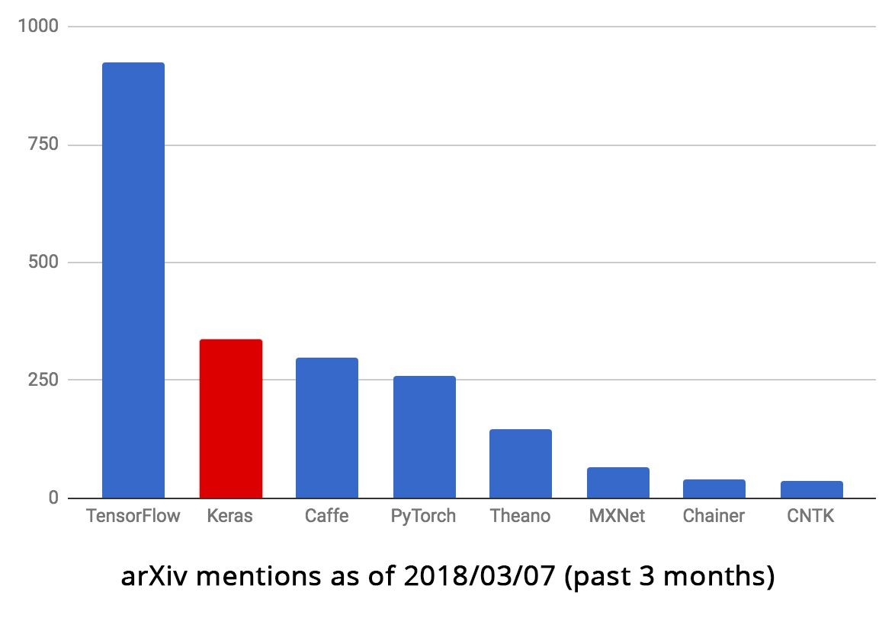
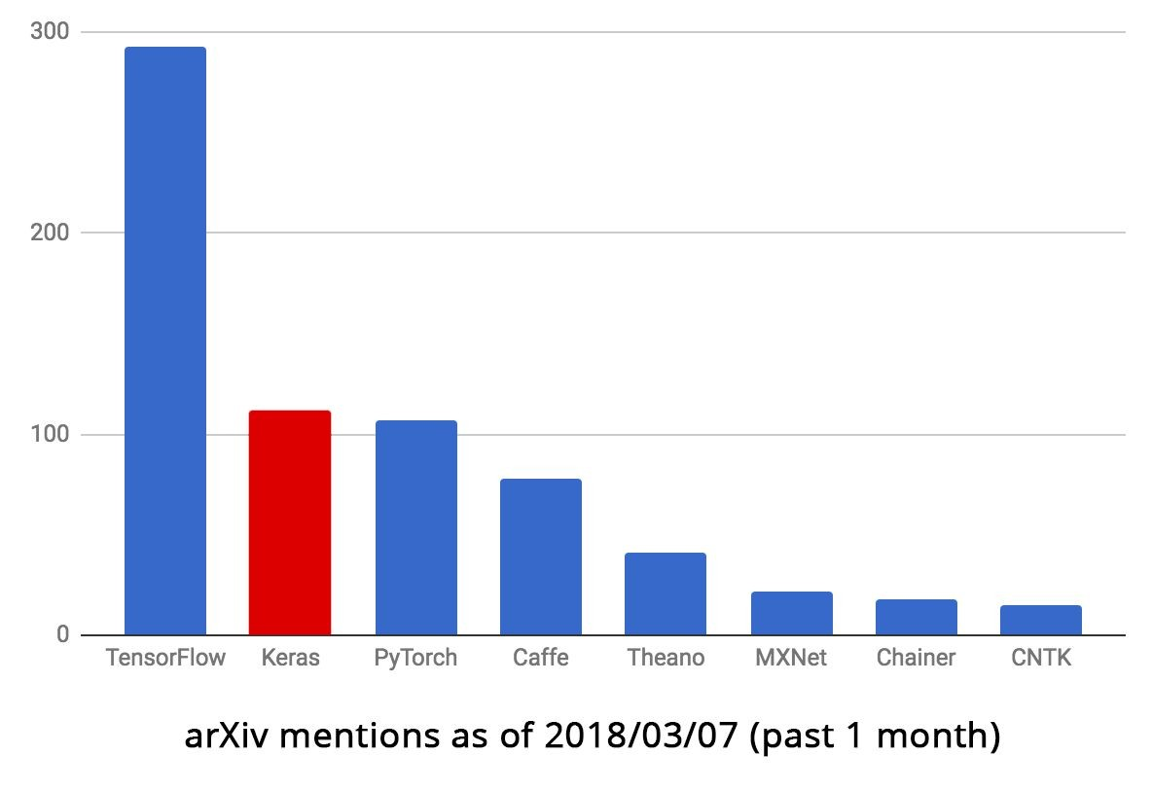
Research traction

Slide 28
Keras is multi-backend, multi-platform
Develop in Python, R
On Unix, Windows, OSX
Run the same code with…
TensorFlow
CNTK
Theano
MXNet
PlaidML
- ??
CPU, NVIDIA GPU, AMD GPU, TPU...

Slide 29
What's TensorFlow™?
Open source software library for numerical computation using data flow graphs?!
Originally developed by Google Brain Team to conduct machine learning and deep neural networks research
General enough to be applicable in a wide variety of other domains
TensorFlow provides an extensive suite of functions and classes that allow users to build various models from scratch

Slide 30
Getting the idea of Computation Graph
Is a specified type of directed graph
A series of functions chained together, each passing its output to zero, one or more functions further in the chain
This will enable user to construct a complex transformation on data by using blocks of smaller mathematical functions
TensorFlow programs are usually structured into a
construction phase, that assembles a graph, and an
execution phase that uses a session to execute ops in the graph
20

Slide 31
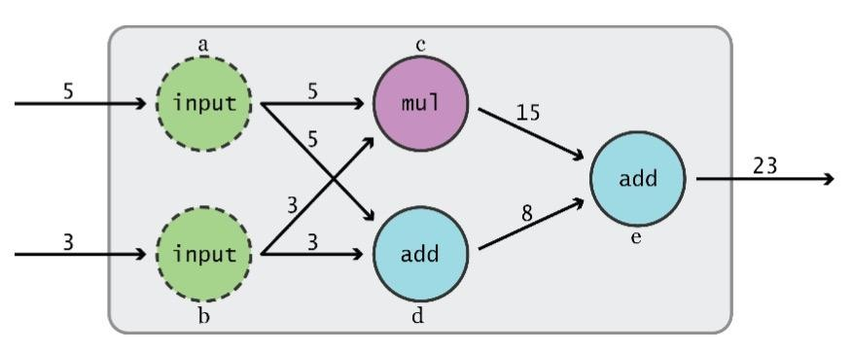
Data Flow Graphs
TensorFlow separates the definition of computations from their execution
Phase 1: assemble a graph
Phase 2: uses a session to execute operations in the graph

Slide 32
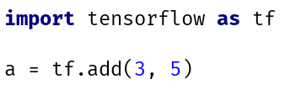
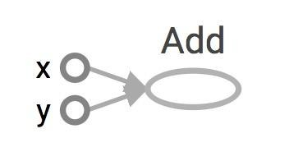
Data Flow Graphs
Visualized by TensorBoard
TF automatically names the nodes when you don't explicitly name them
x = 3
y = 5

Slide 33

Data Flow Graphs
Visualized by TensorBoard
Interpreted?
3
5
a
Nodes: operators, variables, and constants
Edges: tensors
Tensors are data
Data Flow -> Tensor Flow

Slide 34
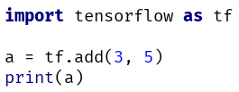
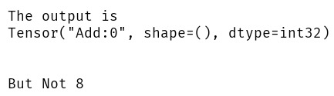
Data Flow Graphs
Visualized by TensorBoard
Interpreted?
3
a
5

Slide 35
How to get the value of a?
Create a session, assign it to variable session so we can call it later
Within the session, evaluate the graph to fetch the value of a

Slide 36
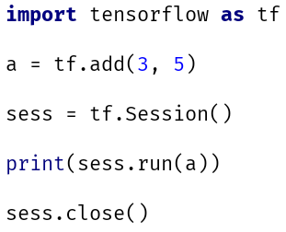
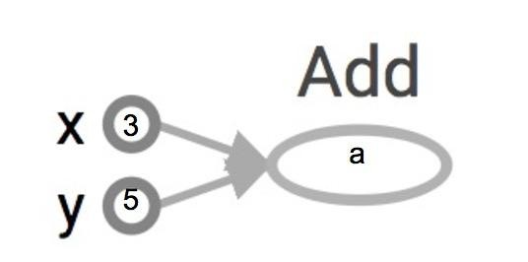
How to get the value of a?
Create a session, assign it to variable sess so we can call it later
Within the session, evaluate the graph to fetch the value of a
8
>>8
The session will look at the graph, trying to think: hmm, how can I get the value of a,
then it computes all the nodes that leads to a.

Slide 37
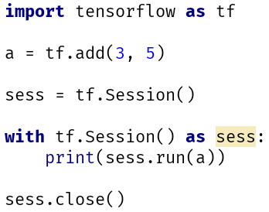
How to get the value of a?
Create a session, assign it to variable sess so we can call it later
Within the session, evaluate the graph to fetch the value of a
8
The session will look at the graph, trying to think: hmm, how can I get the value of a,
then it computes all the nodes that leads to a.
>>8

Slide 38
tf.Session()
A Session object encapsulates the environment in which Operation objects are executed, and Tensor objects are evaluated.

Slide 39
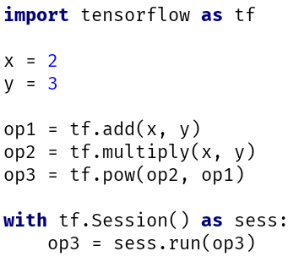
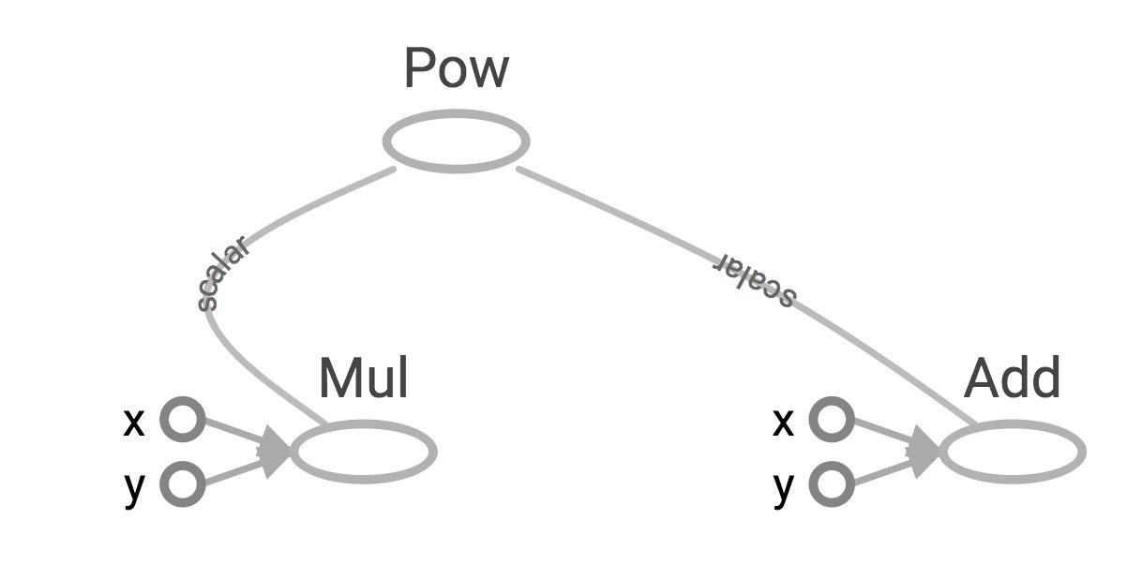
More Graphs
Visualized by TensorBoard

Slide 40
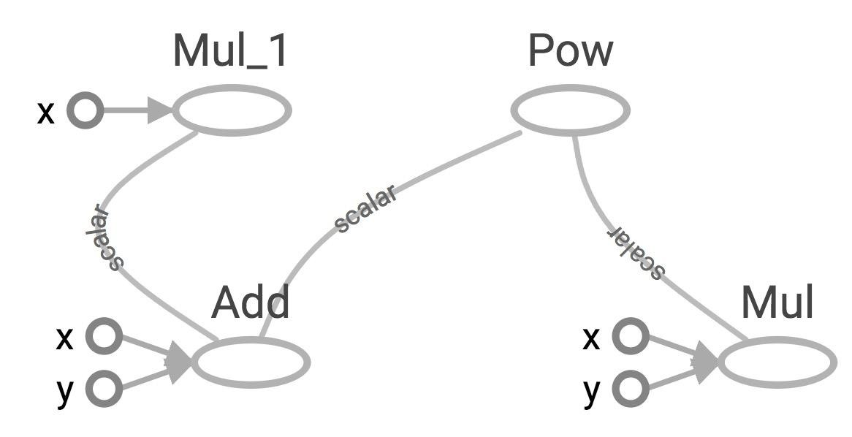
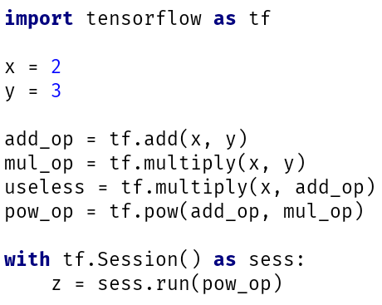
Sub Graphs
Visualized by TensorBoard
useless
pow_op
add_op
mul_op
Because we only want the value of pow_op and pow_op doesn't depend on useless, session won't compute value of useless
→ save computation

Slide 41
What’s Keras
Keras is a high-level library
Models created by Keras can be executed on a backend
TensorFlow (default)
Theano
CNTK (Beta)
It runs smoothly on both CPU and GPU
Keras supports almost all the neural network models – fully connected, convolutional, pooling, recurrent, embedding, etc.
Keras, being modular in nature
facilitate experimentations

Slide 42
Getting started with programming

Slide 43
How to use Keras: An Introduction
Three API styles:
The Sequential Model
Dead simple
Only for single-input, single-output, sequential layer stack
(does not allow cases where you need to create models that shares layers)
Good for 70% of the use cases
The Functional API
Like playing with lego bricks
A lot more flexibility
Multi input, Multi output, arbitrary graph topologies
Like residual networks
Model sub classing
Maximum flexibility

Slide 44
Sequential Model
The sequential model is a linear stack of layers
Create a sequential model by passing a list of layer instances to the constructor
layers are added piecewise via the sequential object
input arrays of shape (*, 1)
output arrays of shape (*, 2)
from keras.models import Sequential from keras.layers import Dense model = Sequential() model.add(Dense(2, input_dim=1)) model.add(Dense(1))

Slide 45
Specifying the input shape
The model needs to know what input shape it should expect
the first layer in a Sequential Model needs to receive information about its input shape
There are several possible ways to do this:

Slide 46
Ways of specifying input_shape
Pass an input_shape argument to the first layer.
This is a shape tuple(a tuple of integers or None entries)
Some 2D layers, such as Dense , support the specification of their input shape via the argument input_dim
model = Sequential() model.add(Dense(32, input_shape=(784,)))
model = Sequential() model.add(Dense(32, input_dim=784))

Slide 47
Functional model
you must create and define a standalone "Input" layer that specifies the shape of input data
"shape" argument is a tuple that indicates the dimensionality of the input data
The layers in the model are connected pairwise
This is done by specifying where the input comes from when defining each new layer
Note how the " input_layer " layer connects to the "Dense" layer
Create the model: As with the Sequential API, the model is the thing that you can summarize, fit, evaluate, make predictions
from keras.models import Model from keras.layers import Input from keras.layers import Dense
input_layer = Input(shape=(2,)) hidden_layer = Dense(2)(input_layer) model = Model(inputs= input_layer, outputs=hidden_layer)

Slide 48
Common attribute of sequential and functional model
Model.layer: flattened list of the layers comprising the model
Model.input: the list of input tensors of the model
Model.output: the list of output tensors of the model
Model.summary(): prints a summary representation of your model
Model.get_config(): returns a dictionary containing the configuration of the model
Model.get_weights(): returns a list of all weight tensors in the model, as Numpy arrays
Model.set_weights(): sets the values of the weights of the model from a list of Numpy arrays

Slide 49
Compilation
Before training a model, we need to configure the learning process via the Compilation method
It receives three arguments:
An optimizer
A loss function
A list of metrics
model.compile(optimizer='rmsprop', loss='binary_crossentropy', metrics=['accuracy'])

Slide 50
Training
Trained on Numpy arrays of input data and labels
Data: Numpy array of training data
Labels: Numpy array of target (label) data
For training a model, you will typically use the Fit() function
import numpy as np data = np.random.random((1000, 100)) labels = np.random.randint(2, size=(1000, 1)) # Train the model, iterating on the data in batches of 32 samples model.fit(data, labels, epochs=10, batch_size=32)

Slide 51

Use case: predict Diabetes

Slide 52
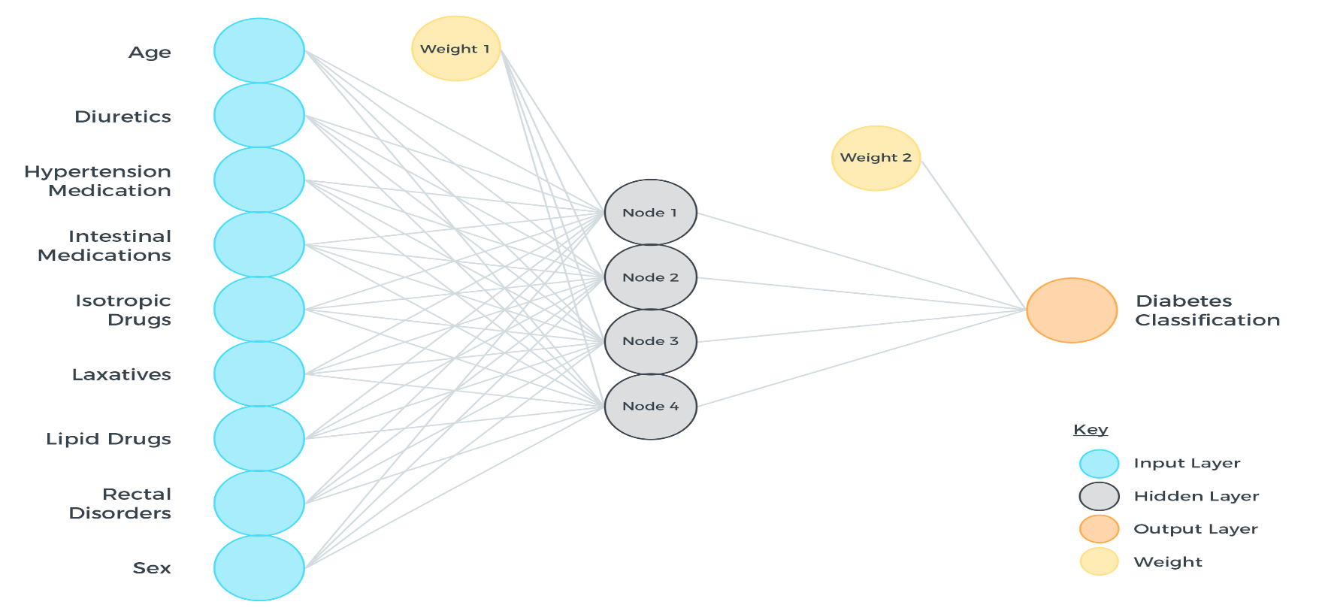
Diabetes Neural Network

Slide 53
Use case: predict diabetes
dataset = pd.read_csv("diabetes.csv", header=None).values # print(dataset) import numpy as np X_train, X_test, Y_train, Y_test = train_test_split(dataset[:,0:8], dataset[:,8], test_size=0.25, random_state=87) my_first_nn = Sequential() # create model my_first_nn.add(Dense(20, input_dim=8, activation='relu')) # hidden layer my_first_nn.add(Dense(1, activation='sigmoid')) # output layer
my_first_nn.compile(loss='binary_crossentropy', optimizer='adam') my_first_nn_fitted = my_first_nn.fit(X_train, Y_train, epochs=100, verbose=0, initial_epoch=0) print(my_first_nn.summary()) print(my_first_nn.evaluate(X_test, Y_test, verbose=0))

Slide 54
Result
Layer (type) Output Shape Param #
=================================================================
dense_1 (Dense) (None, 20) 180
_________________________________________________________________
dense_2 (Dense) (None, 1) 21
=================================================================
Total params: 201
Trainable params: 201
Non-trainable params: 0

Slide 55
References
https://www.youtube.com/watch?v=yX8KuPZCAMo
https://www.linkedin.com/pulse/list-useful-links-videos-slides-articles-deep-farshid-pirahansiah?articleId=6274891035365732352#comments-6274891035365732352&trk=prof-post

Slide 56
Books
TensorFlow for Machine Intelligence (TFFMI)
Hands-On Machine Learning with Scikit-Learn and TensorFlow. Chapter 9: Up and running with TensorFlow
Fundamentals of Deep Learning. Chapter 3: Implementing Neural Networks in TensorFlow (FODL)
Deep Learning with Keras: Implementing deep learning models and neural
20

